Slide 1

Intrusion Detection in IoT Networks Using Deep Learning Algorithms
By: Josimar Kouam
Winter 2023

Slide 2
Outline
Introduction
Proposed methodology
DNN
CNN
LSTM
MLP
ROC and AUC for model comparison
Conclusion and Future works
References

Slide 3
Introduction
Significant increase application of IOT that have become integral part of our daily live
This exponential growth of IOT networks has make it more and more difficult to deal with hostile activity they may be subject to
Lead devices into a constant vulnerability state prone to cyber attack
  Distributed Denial of Service (DDS)
Machine learning as a tool to tackle cyber threats and improve the security of IOTs
  Deep Learning
We propose a deep learning classification based approach for developing NIDS in an IOT environment
Accuracy, precision, recall, and f-measure metrics will serve as evaluation metrics

Slide 4
Methodology
5
UNSW-NB15
Dataset Preprocessing
Training Set
Model Training and Validation
Cleaning
Normalization
Validation Set
DNN, LSTM, CNN, MLP
FS-Feature Selection
Test Set
Model Evaluation
Figure1: Architectural design of the system proposed
Intrusion Detection

Slide 5
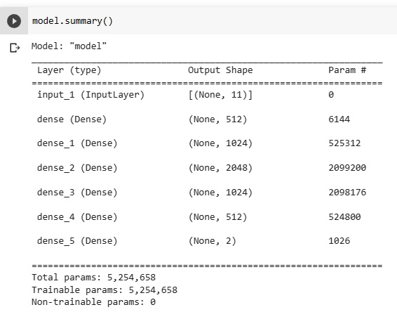
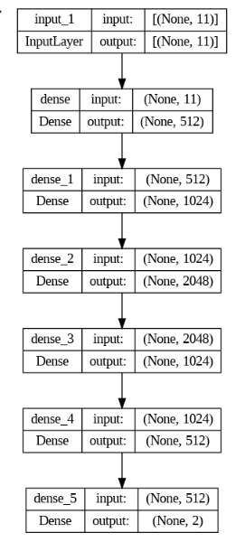
DNN
Activation function:
  Relu
  Sigmoid
Optimizer: Adam
Learning rate: 0,001
Epoch: 100
Batch size: 64

Slide 6
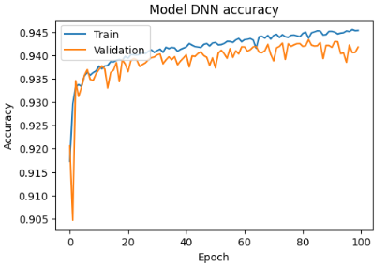
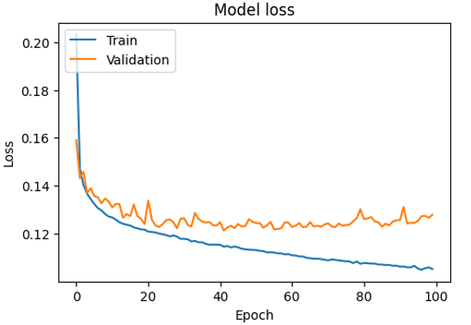
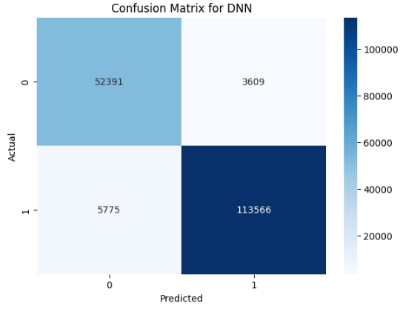
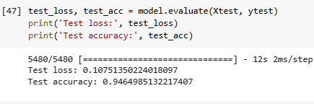
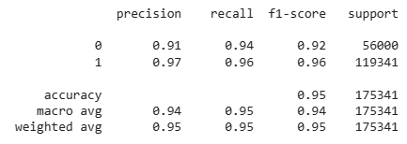
DNN (Cont)

Slide 7
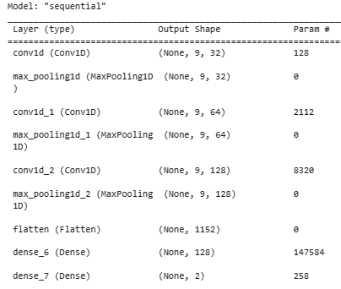
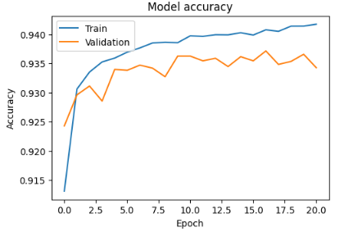
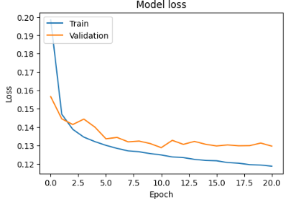
CNN

Slide 8
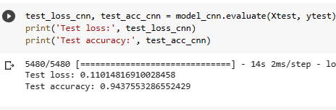

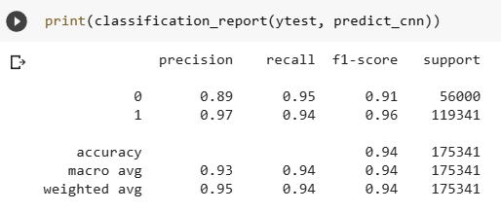
CNN (Cont)

Slide 9
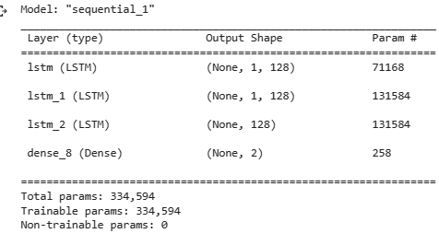
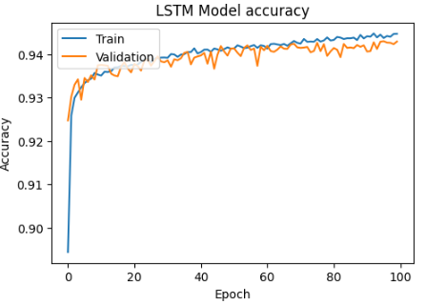
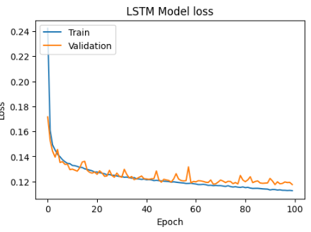
LSTM

Slide 10
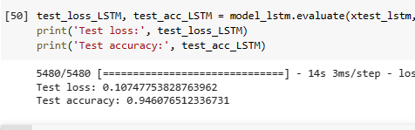
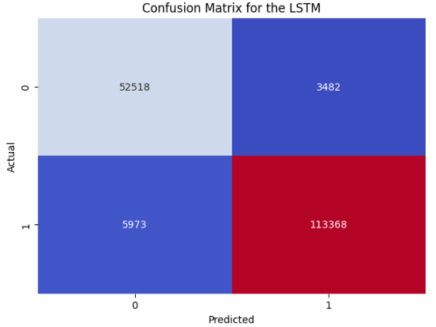
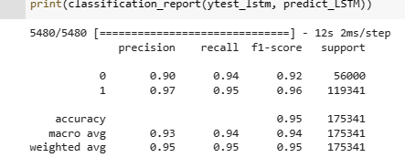
LSTM (Cont)

Slide 11
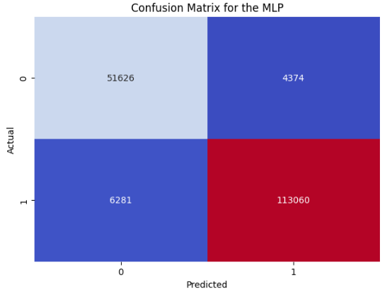
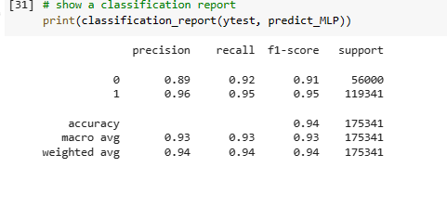
MLP

Slide 12
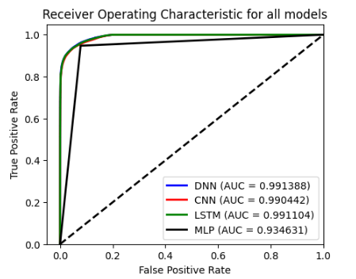
ROC and AUC for model comparison
Notes:
AUC determine which model proposes the best classification

Slide 13
Conclusion and Future works
We presented a study on the use of deep learning methods in detecting intrusions in IoT devices
A standard dataset Bot-IoT for intrusion detection in IoT was used
We have also used different types of Deep Learning methods such as the DNN, CNN, LSTM, and MLP Neural Network for intrusion detection in IoT
DNN provided a better classification model with a lower FN detection rate
Try to improve the scores
Try others DL model such RNN, GRU

Slide 14
References
[1] Susilo, Bambang, and Riri Fitri Sari. 2020. "Intrusion Detection in IoT Networks Using Deep Learning Algorithm" Information 11, no. 5: 279. https://doi.org/10.3390/info11050279
[2] AdvancedDataScienceIBM/IoT-cybersec.all_steps.pandas.ipynb at master · rodolphems/AdvancedDataScienceIBM · GitHub

